Slide 1
Vehicle Blind Spot Assist
Tanzim Mokammel
Valikhan Kuparov
Hani Hadidi

Slide 2
Outline
Reducing Vehicle Accidents
Project Definition
System Level Overview
Modules and Accomplishments
Challenges Ahead

Slide 3
Reducing Vehicle Accidents
Background and Motivation

Slide 4
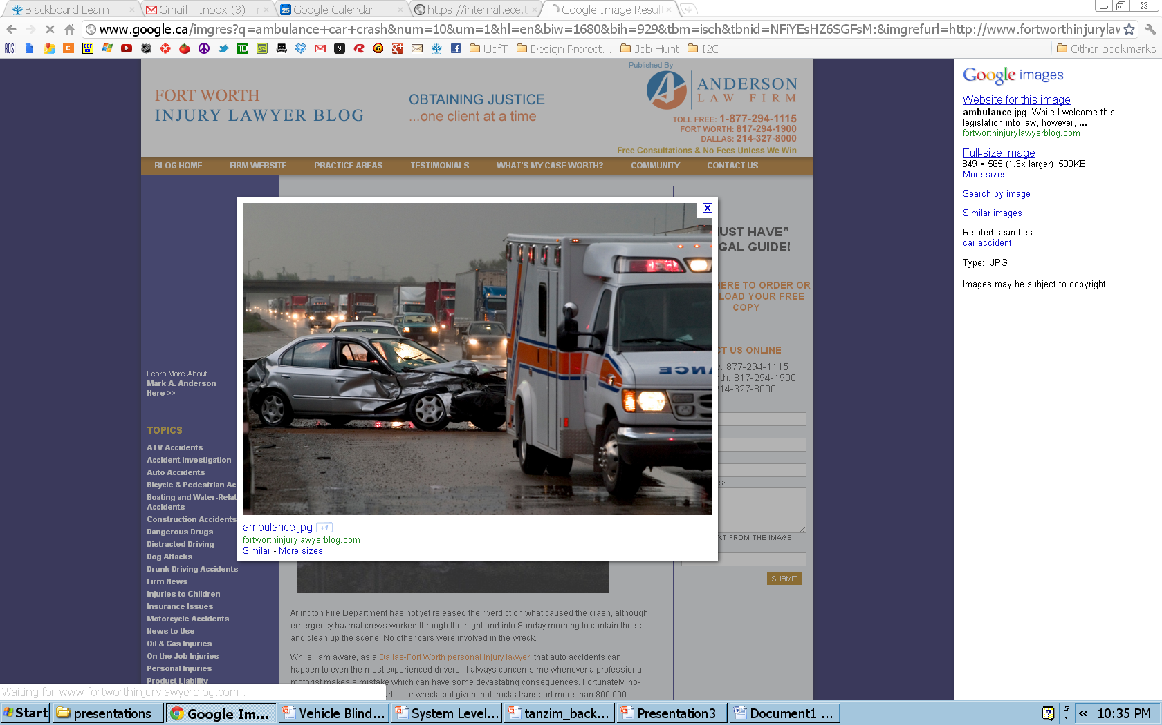
Vehicle Accidents
Vehicle accidents are accountable for:
  Physical injuries
  Mental Trauma
  Financial Loss
  Death
Notes:
http://www.google.ca/imgres?q=ambulance+car+crash&num=10&um=1&hl=en&biw=1680&bih=929&tbm=isch&tbnid=NFiYEsHZ6SGFsM:&imgrefurl=http://www.fortworthinjurylawyerblog.com/truck_bus_wrecks/&docid=6gVGBuWXSdgBTM&imgurl=http://www.fortworthinjurylawyerblog.com/ambulance.jpg&w=849&h=565&ei=bbYgT_j0A4Hn0QH01I3rCA&zoom=1&iact=hc&vpx=904&vpy=54&dur=1625&hovh=183&hovw=275&tx=151&ty=82&sig=106739473343961642775&sqi=2&page=1&tbnh=132&tbnw=173&start=0&ndsp=40&ved=1t:429,r:4,s:0

Slide 5
Accident Rates are Declining
Over the years, we have been seeing a decline in the number of vehicle accidents.
Figure 5: Fatal Collisions and Fatality Victims (1990-2009)
Figure 6: Collisions Resulting in Injury and Victims Injured (1990-2009)
The numbers are still high!
Notes:
[1] Transport Canada, “Canadian Motor Vehicle Traffic Collision Statistics: 2009”, Internet: http://www.tc.gc.ca/eng/roadsafety/resources-researchstats-menu-847.htm, Jun. 01, 2011 [Sep.11, 2011].

Slide 6
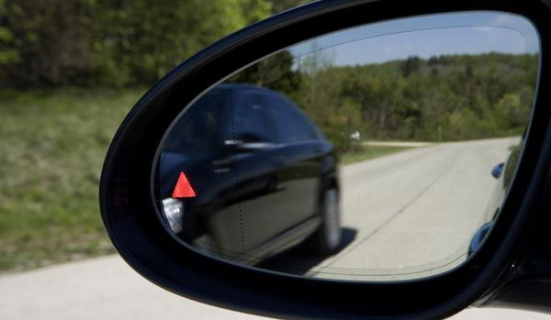
Why the Blind Spot?
95% of accidents are caused by bad driving behavior
One common driving behavior is to not check the vehicle’s blind spot while changing lanes

Slide 7
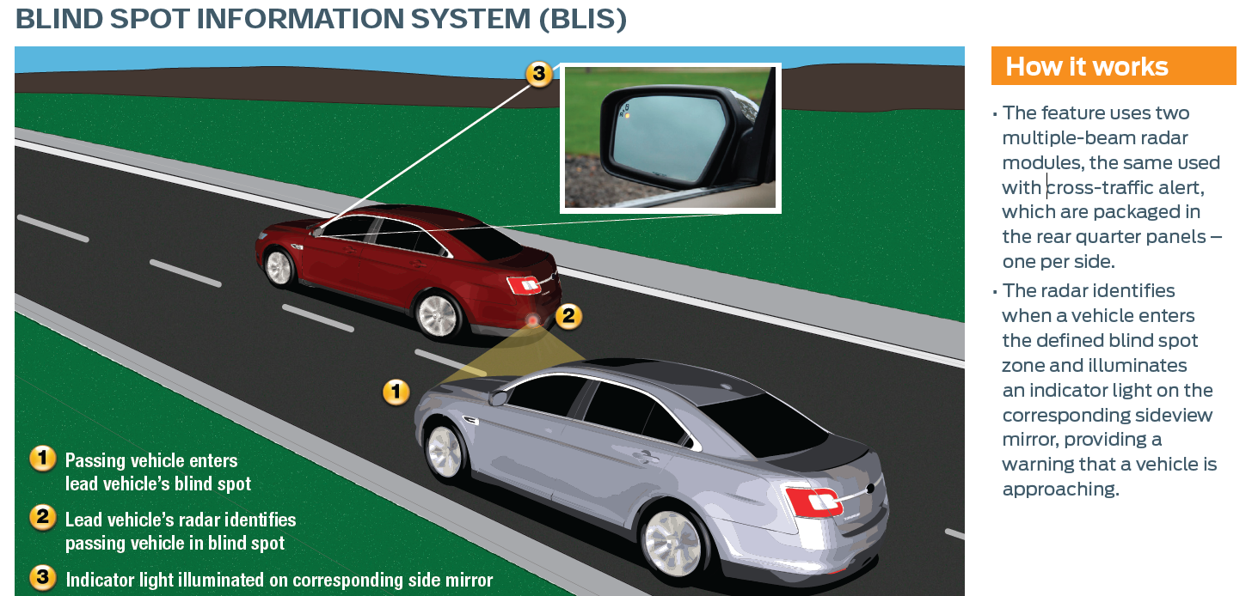
Similar Concerns
Many manufacturing companies have been motivated by similar concerns:
-BMW
-Volvo
-Ford
-Mercedes
Problems
  Not everyone wants a Ford, BMW, etc
  What about older models?

Slide 8
Room for Improvement
Solution
  Help reduce accidents through retrofittable, accessible and affordable device which aids users be aware of dangers in the Blind Spot, and make improvements to the currently available technology

Slide 9
Project Definition

Slide 10

Project Goal
Design a device, which will:
    Identify obstacle in blind spot
    Anticipate approaching obstacle
    Warn user about danger
    Automated lock of steering into obstacle

Slide 11
Project Requirements
Functional Requirements
  The unit shall:
    have sensors mounted on the sides
    have a feedback mechanism to warn the user
    have an override mechanism that will prevent users from making unsafe lane changes

Slide 12
Project Requirements
Objectives
  Work correctly regardless of light and weather conditions
  The blind spot detection component of the unit (no vehicle override) should be a standalone device
  The microcontroller should be hidden from the user’s view

Slide 13
System Level Overview

Slide 14
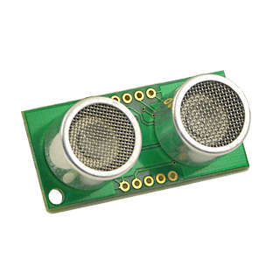
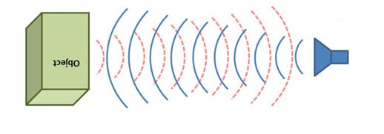
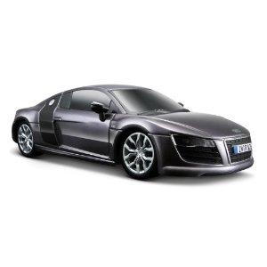

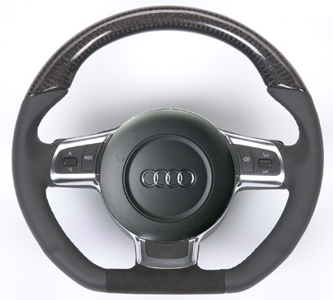
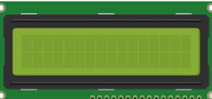
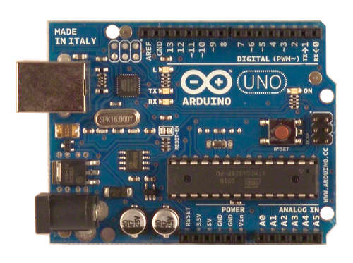
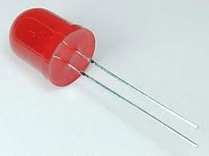
System Level Overview
Detection/Anticipation
Automation
User Vehicle
Echo
F
L
R
Pulse
Ultrasonic Sensor -SRF05
Obstacle
B
Time of Flight
Speed, Direction
Output
Distance
Arduino
LCD screen
Distance, Speed, Time
LED
Blinking Frequency
Speed, time calculations

Slide 15
Modules
and Progress to Date

Slide 16
Detection/Anticipation Module
Arduino
Echo
Pulse
Ultrasonic Sensor -SRF05
Obstacle
Distance
Time of Flight
Speed, time calculations

Slide 17
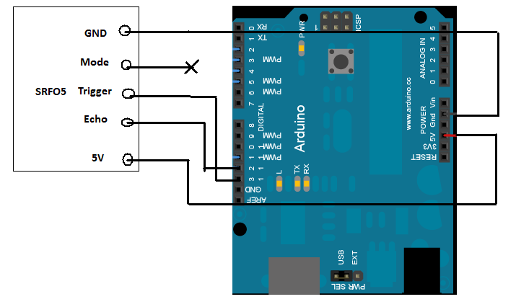
Detection/Anticipation Module – Completed Milestones
Distance Calculations
  Distance between an object and the sensor can be measured to the nearest cm
Sensor
Arduino

Slide 18
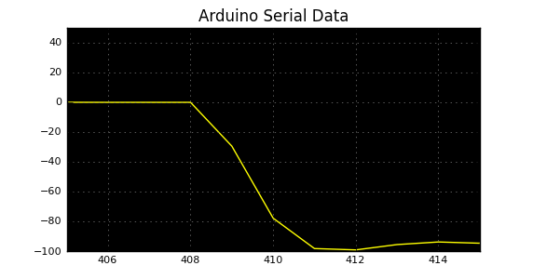
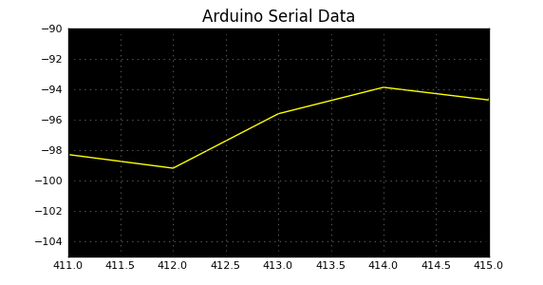
Speed Calculations - Results
Speed Calculations
Speed
Speed
Sample Point
Sample Point

Slide 19
Detection/Anticipation Module – Issues
Sensor’s range (1.5 m to 3 m)
Error of mounted sensors
Real-Time Plots for Verification
Wireless retrieval of microcontroller data

Slide 20
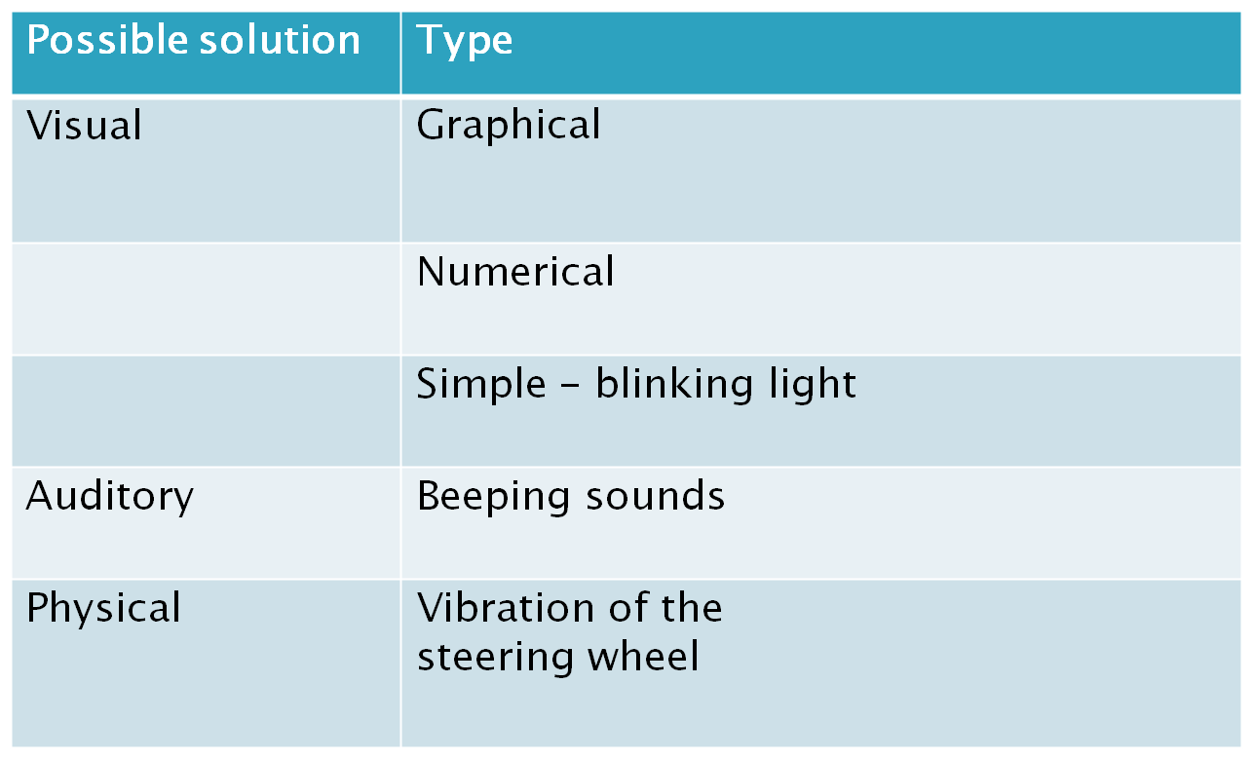
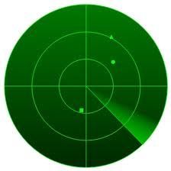
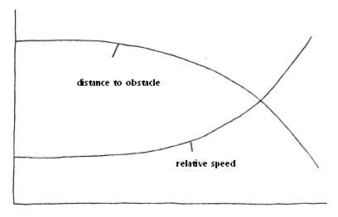
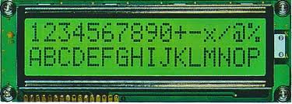
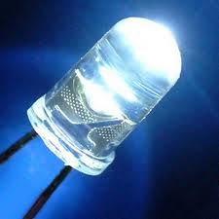

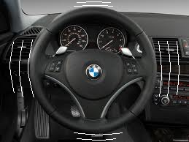
Output Module - Possible Solutions and Design Alternatives

Slide 21
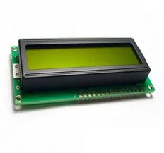
Output Module - Proposed Solution:
LED light and LCD display
+
Advantages:
simple, yet informative feedback
quantitative feedback
the least costly among the alternatives

Slide 22
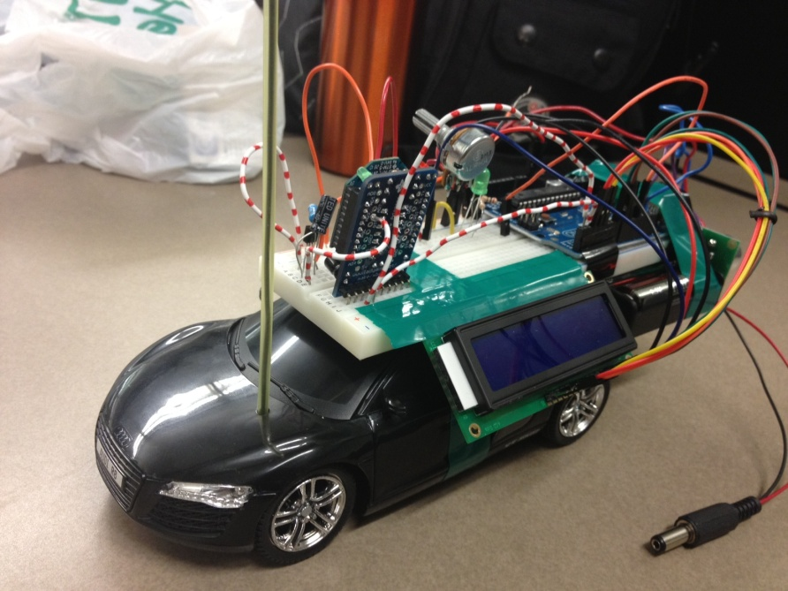
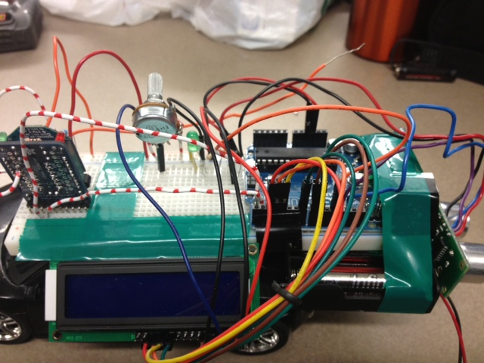
Output Module - Implementation
LED light
LCD Display

Slide 23
Automation
Simulating Driving
Steering lock mechanism
Controlling relative speed
  Verify anticipation module

Slide 24
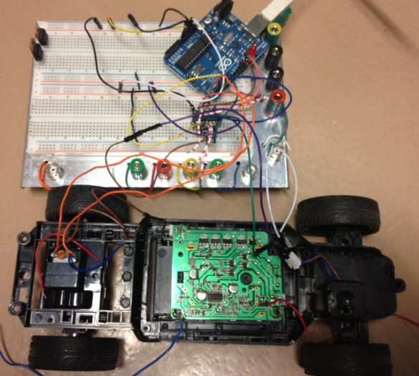
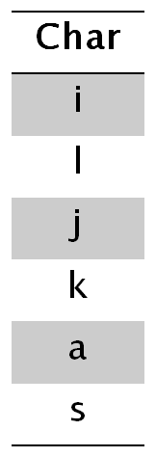
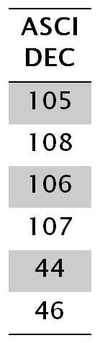


Automation - Input/Output
User Input
Computer output
PWM-
Speed control
F
L
R
B

Slide 25
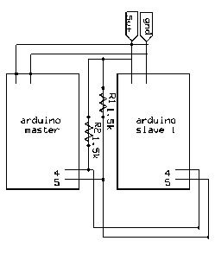
Integration
I2C Protocol to combine processors
Detection + Output + Automation

Slide 26
Challenges Ahead

Slide 27
Summary of Next Steps
Obstacle Detection + Output
  Time calculations
  Improve accuracy
Automation
  Implement Real Time Control
Design Physical Mount System
Testing
  Check Blind Spot Coverage
  Redefine Danger Levels

Slide 28
Conclusion
Project is on track to be completed before design fair
Thank You
Questions?

